Slide 1
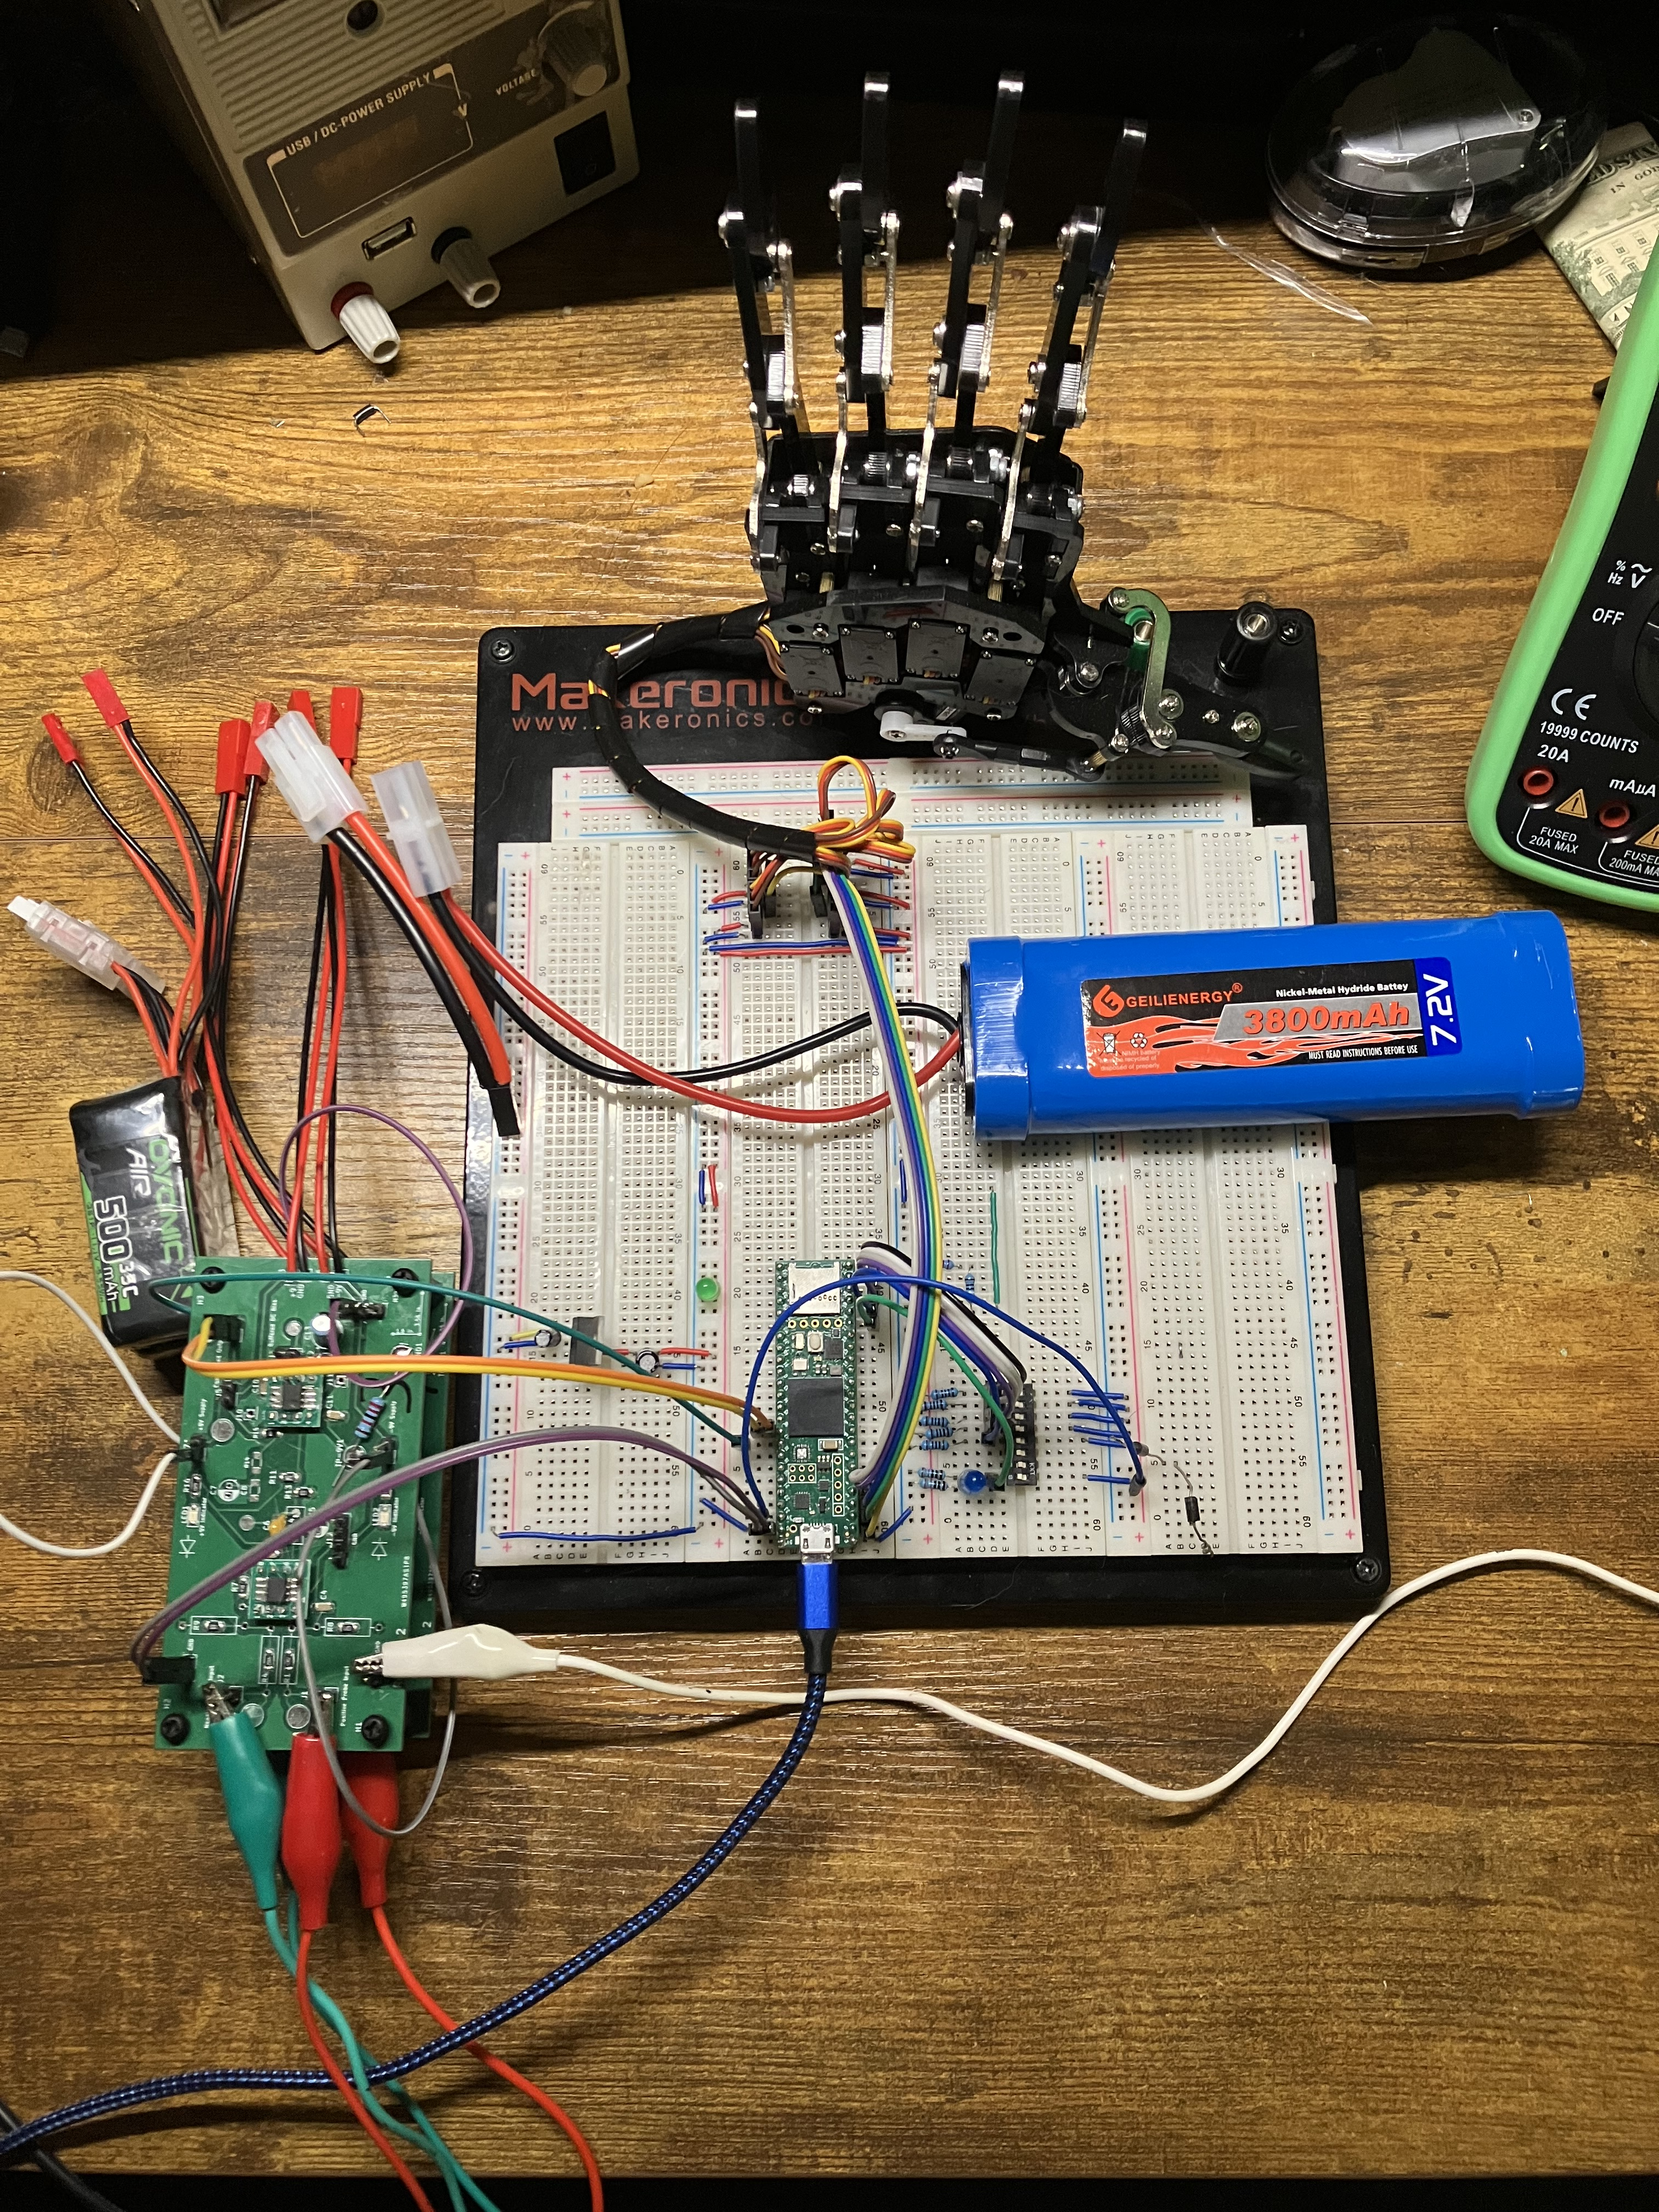
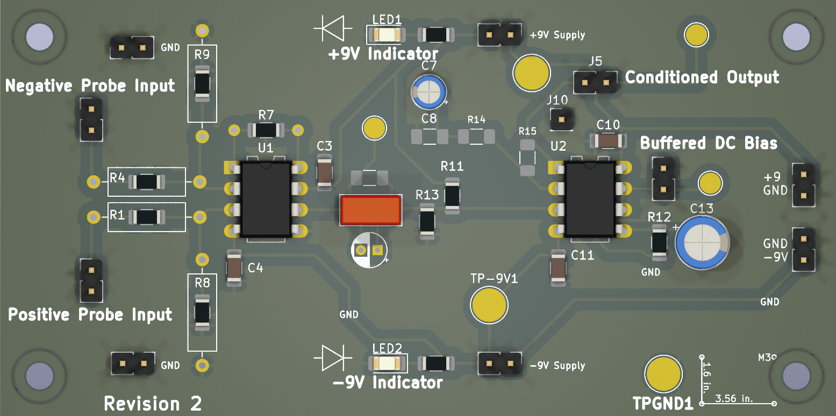
Motorized Robotic Hand Controlled Hand by Surface Electromyography (sEMG)
Authors: Jay E. Bernstein, David J. Mora, Juan R. Ortiz; Advised by Dr. Norali Pernalete
Block Diagram
Abstract
The objective of this project was to discover the fundamentals of signal acquisition and processing, in a situation requiring extremely precise hardware requirements in order to achieve both common mode signal rejection and extremely high gain. Because this is a medical device, considerations of safety had to be made as well. The final product is a printed circuit board designed around the Texas Instruments INA82x that handles differential gain, with input resistance to limit the shock hazard were a fault to occur. The amplified input signal is processed so that a microcontroller is able to determine what command the signal is closest to.
MCU (Teensy 4.1)
Amplifier
Capture 1000 Samples at 40kHz with ADC
Protected Inputs to Instrumentation Amplifier IC
Surface EMG Pads
Normalize, Rectify, and Amplify ADC Input
Robotic Hand
AC Coupled and Buffered Output
Finger Detection Algorithm
Software/Hardware Overview
The hardware is an instrumentation amplifier IC configured for a gain of approximately 2000
Illustration of Finger Detection/Thresholding
Block Diagram showing the acquisition and processing chain for the EMG signals. Muscle activations are sent into the amplifier, which is conditioned so that the onboard ADC of the Teensy can acquire it properly. A 40kHz periodic sample is taken, processed slightly, and used to make a decision on the activation of the robotic hand
A render of the revision 2 amplifier PCB, altered from the manufactured version for clarity. Large silkscreen text is used to emphasize the regions of the board and their operation
Conclusion
Compare amplifier characteristics between discrete inamp, breadboarded ina129, and assembled hardware. Design tradeoffs made, such as removing 60hz HP filter. Nature of MUAPs, long spacing and frequency components. Power supply noise rejection and grounding issues with amplifier. Conclude with what went right what went wrong, what to improve next time
References and Inspiration
Michael Haidar, Jason Hwang, and Srikrishnaa Vadivel, “EMG Robotic Hand,” Cornell University, 2016. Accessed: Apr. 21, 2024. [Online]. Available: https://people.ece.cornell.edu/land/courses/ece4760/FinalProjects/f2016/mh2298_jyh37_sv376/mh2298_jyh37_sv376/mh2298_jyh37_sv376/index.html
6mm 8mm 10mm 20mm 30mm. 32Point = 0.5 inch High

